Slide 1
WELCOME!
Understanding the Current Budget Crisis
Sponsored by: Reviving Rapid City Schools
Notes:
Asking the questions, finding the answers, starting the dialogue. revivingrapidcityschools.weebly.com

Slide 2
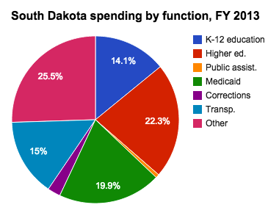
What is the budget crisis?
In the last 10 years State Aide to schools dropped 10%
K-12 schools receive less than 15% of the States Budget for education.

Slide 3
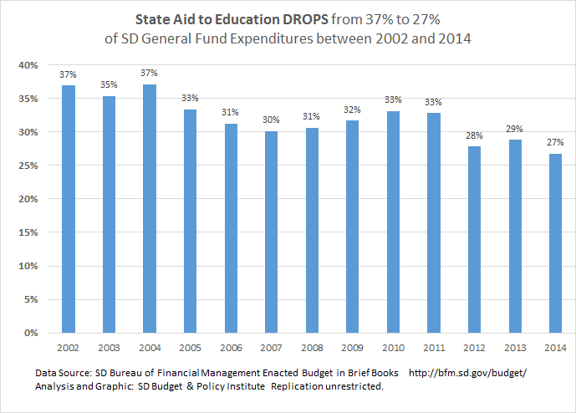
Notes:
From Joy Smolnisky at the SD budget and policy institute:
In 2004, South Dakota invested 37% of its general fund expenditures in state aid to K-12 education. By 2014 that had plummeted to 27%. That is a drop of over 25%. (See Chart 1)
Well, for some unknown reason, when the education funding formula was established South Dakota decided to freeze its investment in K-12 education to include inflationary increases only, diverting all real growth in state revenues away from education.
Back in the early 1990’s South Dakota used to track with the nation, investing an amount equivalent to about 5% of the total personal income in our state toward K-12 education. But while the rest of the USA has stayed pretty true to the 4.5 to 5% level of investment, South Dakota has not. (See Chart 2)
Chart 2: Funding Formula diverts real economic growth away from k-12 education funding
In the late 1990s South Dakota implemented its “No-real-growth Funding Formula” for K-12 education. That is when our state investment in K-12 education begin to erode relative to the rest of the nation. By 2012, South Dakota spending on K-12 was only 3.5% of personal income.
If South Dakota continues its current strategy, diverting all revenue increases from real economic growth away from K-12 education, funding for each generation of students will continue to fall further and further behind our neighbors and our nation
How has this disavowing responsible K-12 funding harmed the education of our children?
Let’s look at one of the things that has happened. Back in 2003, South Dakota’s fourth graders scored above the national average in reading. By 2013, well over half our students (68%) were not proficient in reading by 4th grade.
See the blue line in chart 3 (that is the national scoring average). South Dakota is the red line. Shocking, right?
Today, students across the nation are scoring higher than our own South Dakota students. All our neighboring state’s students are holding their own, placing above that rising national average. But South Dakotans are lagging, dropping behind both the national scores and regional scores.
An email of these research results to the South Dakota Secretary of Education was met with a reply that said we used to have a very effective reading program, which ended in 2005 when grant funding ran out. That’s a burden, but then South Dakota didn’t replace it with an equally effective program. Why? We apparently didn’t want to fund our own effective reading program.
Should we be concerned about this?
SD DOE research on outcomes for 4th Grade students not proficient in reading
Yes, according to South Dakota Department of Education research published this week (Chart 4). If we apply the report’s findings to the 68% of South Dakota’s 2013 4th graders who weren’t proficient in reading, we can predict that in 2021 when they graduate:
Less than 50% of graduates will have taken the ACT
Less than 36% of graduates will have met the ACT English benchmark
About 10% of graduates will have dropped out
Summary
This data suggests it may be time for South Dakota to take a serious look at its current funding formula, a formula that has frozen and stagnated K-12 investments at the same inflation-adjusted level for over 15 years. And we know the human and monetary expense of remediating current and future generations of graduates in incalculable.
The ability of our students to read and the ability of our teachers to teach them to read is not the problem. The lack of adequate funding is the real, true issue, and it is harming our state’s ability to successfully transition our children from high school to being productive, economically viable adults. We think that transition is worth the investment.
SD Budget & Policy Institute has shared these findings over the past five months in eight** South Dakota communities holding meetings with several hundred people and generating extensive media coverage. Responses consistently reflect deep concern. Every group unanimously agreed, “doing nothing” (i.e., staying with the existing funding formula) was unacceptable.
http://www.sdbpi.org/portion-of-sd-state-taxes-dedicated-to-k-12-education-drops-by-25-in-last-10-years

Slide 4
How Are Schools Funded?
Per Student Allocation –PSA
The State Guarantees a set amount of money to a school district per student
It Comes From
Local Property Taxes + State Aid
It is expected to grow each year
3% or
Consumer Price index (About 1.5-2%)
Which ever is less.
Notes:
State Aid 101 presentations will give more in-depth information.
http://doe.sd.gov/secretary/documents/StateA101.pdf

Slide 5
Video Lottery Money
50% of Video Lottery earnings are deposited into the State General Fund.
It is used to fund pre-K through post high school education across the state.
The State pays its portion of the Per Student Allocation (about 55%) from the State General Fund.
Video lottery money already provides a 30% reduction in the property tax burden for South Dakota Citizens!
Notes:
What Happened to the Video Lottery money that was supposed to pay for education?
50% of the revenues from video lottery are paid to the State of SD by being deposited into the “Property Tax Reduction Fund”. See this link to South Dakota Codified Law 42.
http://legis.sd.gov/Statutes/Codified_Laws/DisplayStatute.aspx?Type=Statute&Statute=42-7A-63
This fund was eliminated this year, 2015, and now revenue appears to go straight into the State General Fund. The State General Fund, funds k-12 schools via a per student allocation each year. About 55% of that allocation is paid by from the State General Fund reliving the tax burden on owner occupied and agricultural property. The other 45% of this PSA is generated through local property tax levies. Without video lottery, property owner would bear closer to 100% of the burden to fund schools.
The moneys in the property tax relief fund may be transferred to the general fund as necessary to provide property tax relief through state aid to education. See link to view statute.
http://legis.sd.gov/Statutes/Codified_Laws/DisplayStatute.aspx?Type=Statute&Statute=10-13-44
Here is a link describing the history of the South Dakota Lottery. It states “This fund [Property Tax Reduction Fund] reduces local property taxes on owner-occupied and agricultural land by 30 percent”
http://www.naspl.org/Contacts/index.cfm?fuseaction=view&ID=35
Here is an editorial from the Rapid City Journal in 2013 stating South Dakota’s income from video lottery is dropping.
http://rapidcityjournal.com/news/opinion/editorial-video-lottery-must-change/article_249e06cd-7cd1-59b7-bb94-d1efd6fc8a56.html
42-7A-63. State's percentage of net machine income--Deposit into property tax reduction fund and in video lottery operating fund. The commission shall maximize revenues to the state from video lottery. The state's percentage of net machine income shall be fifty percent. The state's percentage of net machine income shall be directly deposited to the property tax reduction fund, except for one-half of one percent of net machine income authorized for deposit into the video lottery operating fund. The effective date of this section is July 1, 1996.
Source: SL 1993, ch 318, § 3; SL 1994, ch 330; SL 1995, ch 243, § 2; SL 1996, ch 72, § 2B.
10-13-44. Property tax reduction fund--Distribution of money--Tax credit payments. The property tax reduction fund is hereby created in the state treasury. The Department of Revenue shall distribute any money appropriated to the fund. Effective January 1, 1996, through December 31, 1996, the State of South Dakota may remit tax credit payments on a monthly basis for eligible property taxpayers on or about the last day of every month. Tax credit payments shall be sent to counties based upon information received from the counties pursuant to § 10-13-43. In fiscal year 1997 and each year thereafter, the commissioner of finance and management may transfer moneys available from the property tax reduction fund to the general fund necessary to provide property tax relief through state aid to education.
/* Style Definitions */ table.MsoNormalTable {mso-style-name:"Table Normal"; mso-tstyle-rowband-size:0; mso-tstyle-colband-size:0; mso-style-noshow:yes; mso-style-priority:99; mso-style-parent:""; mso-padding-alt:0in 5.4pt 0in 5.4pt; mso-para-margin:0in; mso-para-margin-bottom:.0001pt; mso-pagination:widow-orphan; font-size:12.0pt; font-family:Cambria; mso-ascii-font-family:Cambria; mso-ascii-theme-font:minor-latin; mso-hansi-font-family:Cambria; mso-hansi-theme-font:minor-latin;}
Source: SL 1995, ch 57, § 31; SL 1996, ch 72, § 2C; SL 2003, ch 272 (Ex. Ord. 03-1), § 82; SL 2011, ch 1 (Ex. Ord. 11-1), § 161, eff. Apr. 12, 2011.

Slide 6
Historic Increases to PSA
Historical Increases in the Per Student Allocation
 |  | 2010 | 2011 | 2012 | 2013 | 2014 | 2015
PSA |  | $4,805 | $4,805 | $4,390 | $4,491 | $4,626 | $4,781
$increase |  | $140 | $0 | -$415 | $101 | $135 | $155
% increase funded |  | 3.00% | 0% | -8.60% | 2.30% | 3.00% | 3.40%
We did get a 3.4% increase this year.
However, this does not restore our levels to the 2010 amount.
Notes:
Historically the Per Student Allocation rose by 3% every year until 2011 when it was given a 0% increase and then cut by 8.6%. While the State gave schools some of the surplus at the end the legislative budgeting sessions, this is not a consistent or dependable revenue source. This chart also does not take inflation into consideration.

Slide 7
Understanding Funding
The State cut to the PSA of 8.6% in 2011 resulted in a 7-10 million dollar loss per year to schools across the state.
(This is considering if they had actually given the increase of 2-3% each year.)
Notes:
This is our estimation after calculating the facts from the SD DOE budget 101 presentation.

Slide 8
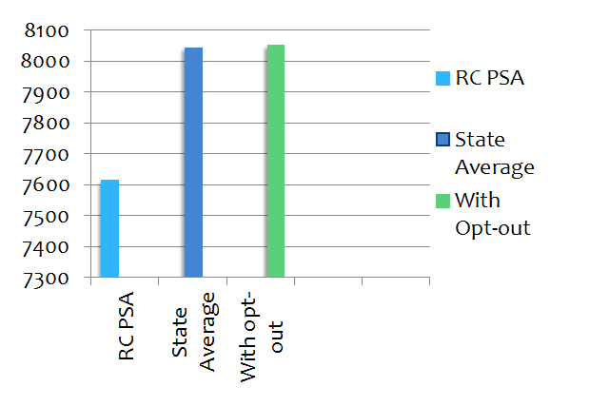
RCAS PSA
Without increased funding, the district will have to cut 60-70 positions a year.
This is even if the State increased the PSA by 3% every year.
That is the equivalent of
3 million dollars a year
in cuts.
Notes:
RCAS spent $7, 611 per student in 2013-14, where the state average is $8,040.
The requested opt-out would increase the amount RCAS spends per student by approximately $438 dollars, bringing our per student spending up to the State average.
Without increased funding, the district will have to cut 60-70 positions a year. This is even if the State increased the PSA by 3% every year. That is the equivalent of 3 million dollars a year in cuts.

Slide 9
The Role of RCAS
RCAS spent $7, 611 per student in 2013-14, where the state average is $8,040.
The requested opt-out would increase the amount RCAS spends per student by approximately $438 dollars, bringing our per student spending up to the State average.
Without increased funding, the district will have to cut 60-70 positions a year. This is even if the State increased the PSA by 3% every year. That is the equivalent of 3 million dollars a year in cuts.
Notes:
The end result of the opt-out is to provide adequate revenue for the school district to operate it's General Fund. 80% of that General Fund is used to pay salaries.
If we do not support the Opt-out we are only punishing teachers and staff within the district. Do we need to wait for reform and change within the district to adequately compensate our teaching staff? Can we pass the opt-out and then rally as a community to make changes within the district that will promote higher expectations and offer students experiences to learn individually at high levels? What will you vote for?

Slide 10
Opt-Out By Design
Per state funding statutes, a school district can “opt-out” of tax levy limitations. The state “caps” how much money can be taken out of taxes and given to schools. We need money beyond that cap to fund our schools. The public can vote on an “opt-out”.
"I am a big believer in local control…" Governor Daugaard–Argus Leader, Jan. 2011 "The judgment should be made locally, based on what is best for the children and the taxpayers in that district.“ 2011 gubernatorial press release, Feb 18, 2011 "I want to allow local school boards and school administrators to run their own districts. I will be sponsoring bills this year to repeal the 100 student minimum for state aid to school districts, and to remove the cap on school district reserve fund balances. We must trust local officials to make the best decisions for their districts.” 2011 South Dakota State of the State Address , Jan 11, 2011
Notes:
Schools do not get all of the tax money collected from property tax. For example, let's say you pay $2500 a year in property taxes; it goes to multiple support services. That $2500 dollars does NOT go directly to the schools. The money is divided up and used in various places. Some of it goes to the schools but the rest is used by the county. Secondly, increased valuations does NOT mean more money for the schools. The amount of money we received is capped.

Slide 11
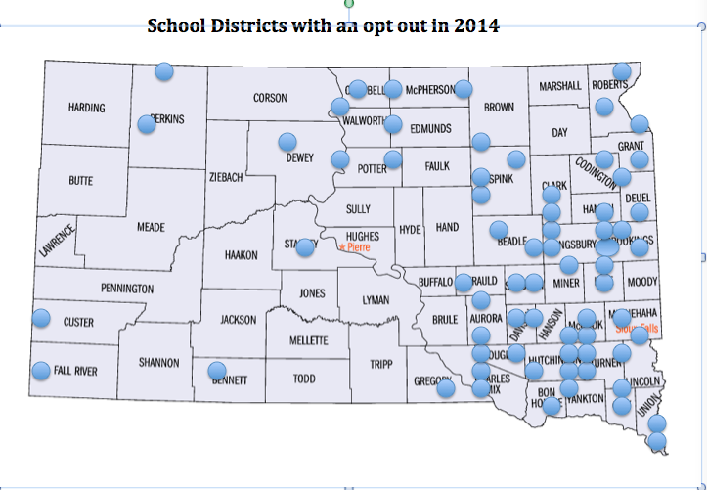
44% of School Districts with Opt Outs
Notes:
This is not a problem confined to Rapid City. It is the intent of the State Government to shift the tax burden to the local Districts. The funding formula specifies this as an option.
We can choose austerity or investment.
School Administrators of SD website has a pdf of all districts and their apt-out amounts

Slide 12
2009 Citizen Finance Commitee Recomendations
1. Reduce staff and/or programs.
2. Increase teacher to student ratio efficiencies.
3. Consolidate or close schools.
4. Consider an interim “opt out” if 1-3 do not balance the budget.
5. Change the State Aid funding formula through the Legislative process.
The Committee encourages the RCASD Board of Education and Superintendent
to be pro-active in exercising leadership by re-engaging the entire community in
support of public education. The RCASD should invite all stakeholders;
taxpayers, students, parents and teachers to participate in a strategic planning
process with the ultimate goal: to ensure a quality education system.
1-3 have been done. The district is now trying to implement 4 and has been lobbing intensely for 5

Slide 13
Administrative Cuts
In 2010 our district had 9 coordinator positions at central administration. We now have 4.
Rapid City District
Sioux Falls District
5.4% Administrative Cost
This cost includes
Principals
Central Administration
IT support
Psychologists
7% Administrative Cost

Slide 14
RCAS Cuts
Instead of asking for an opt-out during those years, the school district made significant cuts.
Restructured programs:
Added all day kindergarten
Middle School teachers decreased
Class sizes increased
Teacher pay was frozen and healthcare costs increased
Restructured the Literacy program and decreased the literacy support at all levels
85-87 position eliminated for 2015-2016 school year
The reserves were spent down to recommended levels
Notes:
Cuts for this year including literacy and math support staff will have a direct effect on elementary students capacity be proficient in reading.
Cut to the administration has left one person in charge of the entire budget, the facilities management and the Human Resource department.

Slide 15
Our Options
The State Legislature can add the difference onto the PSA
The School District can ask for an Opt Out of property tax limitation
On March 24, 2015 the BOE voted to ask for a $6 million increase each year for 5 years.
This makes up the difference for the future, but not the past.
We can continue to make cuts to vital programs that are needed to educate our kids.
Notes:
Sales tax has to come from a legislative rule change in the statute. If we ever do get more than the 3% maximum offered by the state, it is a one-time occurrence. It is not money that can be counted on year after year. In 2012, voters rejected the governor’s education reform plan which was HB 1234. Voters and the Governor also opposed initiated measure 15. It would have raised South Dakota’s sales tax by one cent. This money was earmarked for education and Medicaid. It would have given schools approximately $725 more per student annually. Since it did not pass, we did not gain that funding.

Slide 16
Teacher Salaries Growth Comparisons
Source: Sioux Falls School District School Funding 101, January 29, 2015 , Todd Vik, Business Manager and
SDBPI -http://www.sdbpi.org/current-salary-policy-for-south-dakota-state-employees
Notes:
From 1995-2005 Teacher salaries grew at 2.7% Compared to State Employees at an average of 3% and Private Workers at 4.1%.
From 2005 -2013, during economically hard times, teacher salaries grew at 1.7% compared to 3.3% in the private sector.
The data shows that the State has been underfunding the State Aid to Education Formula. The State Aid formula pays for 80% of a district’s general fund which consists mainly of salary expenses. Because of this districts cannot afford to increase teacher pay beyond the rate of funding formula increase over a sustained period of time. That rate of increase is has only been 1.7% since 2005. This is the main reason why teacher salaries have been frozen except for one time moneys.
Data sources:
Sioux Falls School District School Funding 101-Fast Facts, January 29, 2015 , Todd Vik, Business Manager
http://www.sf.k12.sd.us/index.php?option=com_flexicontent&view=items&cid=70:community&id=237:current-legislative-positions&Itemid=467

Slide 17
Why Do Teacher Salaries Fall Behind?
Underfunding the State Aid Formula
Source: Sioux Falls School District School Funding 101, January 29, 2015 , Todd Vik, Business Manager
Notes:
The State funding for education has only grown by an average of 2.2% for the past 16 years. The State Aid formula funds the local School districts General Funds which are 80-90% used to pay District salaries.
Sources: http://www.sf.k12.sd.us/index.php?option=com_googlesearch_cse&n=30&Itemid=84&cx=002284888573374030398%3A94uc6ulprmy&cof=FORID%3A11&ie=ISO-8859-1&q=teacher+pay&sa.x=-712&sa.y=-7&sa=Search&hl=en&safe=active&cr=countryUS
It is interesting to note, that the State’s General fund has increased at 2.9%, allowing them to increase the salaries of other State workers at a higher level than schools are able to afford for their staff.
Interesting that the State General fund growth is higher than that given to schools.

Slide 18
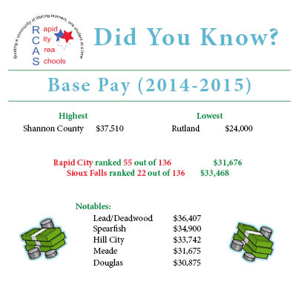
Notes:
Low base pay in Rapid City Schools results in teachers leaving the district for neighboring districts and neighboring state. The music teacher at Southwest Middle School is leaving for a neighboring state and will earn a combined increase of $30,000 to their salaries.

Slide 19
Results of Salary Contract Negotiations RCAS past 5 years
Year | Step or Lane | % Increase
2007-8 | Drop 2 steps / add a step to those who qualify | 4% to base
2008-9 | Increase a step | % .5 increase plus enhancement dollars to those who did not increase with a step
2009-10 | No Step | 0%
2010-11 | Increase a step | 2% increase
2011-12 | No Step | 0% reduced 2 work days
2012-13 | No Step | 2% one-time salary
2013-14 | No Step | 5% one-time salary
2014-15 | No Step | 3% base pay increase 2% one time salary
Notes:
The School district does not have enough revenue to support sustained pay increases. A beginning teacher will never reach the pay of a teacher with 15 years of experience in this district. So those who can, leave.
Data obtained from RCAS
Steps are based on years of experience. Pay increases are supposed occur every 2 years
Lanes are based on receiving a higher degree
From Rapid City Journal 10/26/14
Rapid City Teachers’ pay doesn’t conform to district’s chart

Slide 20
Property Class Tax Calculations
School General Fund Tax Calculations by Property Class
 | 2012 Levy | 2012 | % | 2013 Levy | 2013 | % | 2014 Levy | 2014 | %
Owner Occupied | 4.029 | $13,794,111 | 42% | 4.296 | $15,349,147 | 42% | 4.252 | $15,915,821 | 42.5%
Other Non-Ag/Utilities | 8.628 | $19,299,335 | 57.8% | 9.20 | $20,510416 | 57.8% | 9.106 | $21,433,341 | 57.3%
Agricultural | 2.322 | $70,247 |  | 2.09 | $72,013 | .2% | 1.782 | $68,310 | .18%
Total |  | $33,163,694 | .2% |  | $35,931,576 |  |  | $37,417,473
State Aid |  |  |  |  | $28,091,220

Slide 21
The Future
What does a 21 century education look like to you? What do great schools look like? What opportunities could your child miss out on due to lack of funding?
Without this opt-out we have to ask ourselves, “What RCAS will be able to offer our children?” How can we continue making this many cuts each year? If an opt out is passed, we will keep asking questions, finding the answers and maintaining an open dialogue. We are fighting for the best education for each child in Rapid City.

Slide 22
Information Resources
revivingrapidcityschools.weebly.com
RCAS.org - budget facts
SD Department of Education
http://doe.sd.gov/secretary/documents/StateA101.pdf
South Dakota Budget and Policy Institute
Powerpoint for South Dakotans Talking k-12 education funding
Sdbpi.org
Notes:
All links below can be found on Reviving Rapid City Schools.weebly.org

Slide 23
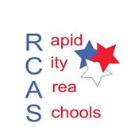
The Panel
Question and Answer Session
We would like to thank Dr. Mitchell,
Mr. Janak, and Mr. Davis for taking the time to explain the school districts budget to the community.

